Slide 1
The application of electronics in modern cars
Gematogen Karman, PIN-25

Slide 2

Vocabulary
Dashboard – приборная панель
Gauge – датчик
Central hub – центральный узел
Embedded – встроенный
Driving range – запас хода

Slide 3
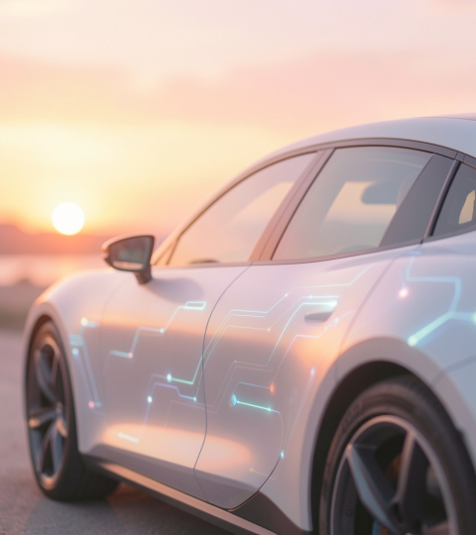
Modern car is a
computer on wheels
It has:
Sophisticated software
Complex webs of electronics
Embedded wireless technologies

Slide 4
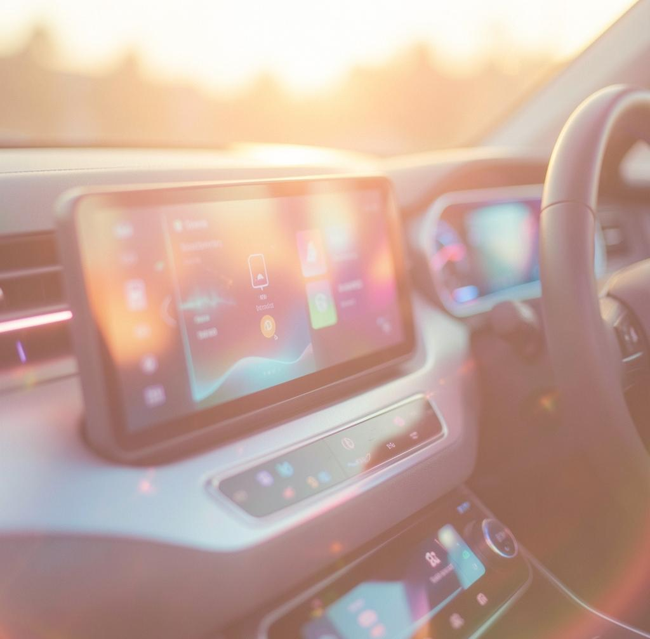
Where does all this computing power go?
To three main areas:
Driving assistance systems
Battery management
Dashboard screens

Slide 5
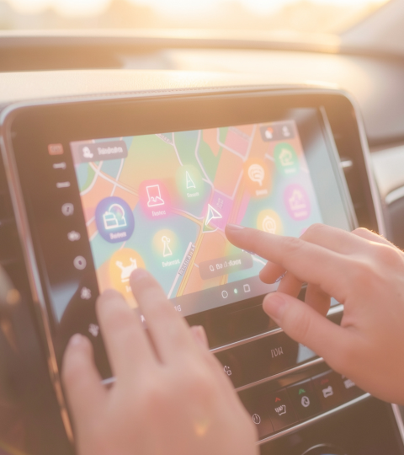
Software problems
More lines of code mean more entry points for hackers. Also, a single bug can endanger driver’s life.

Slide 6
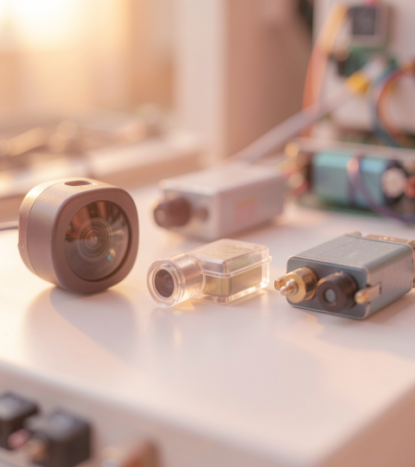
Cold weather problem
When the temperature drops below freezing, the chemical reactions inside the battery slow down, resulting in 50% drop in driving range.

Slide 7
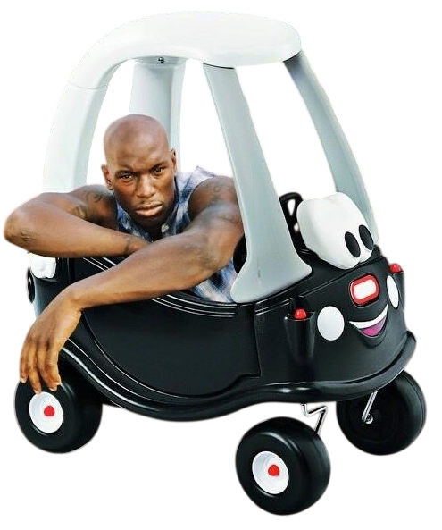
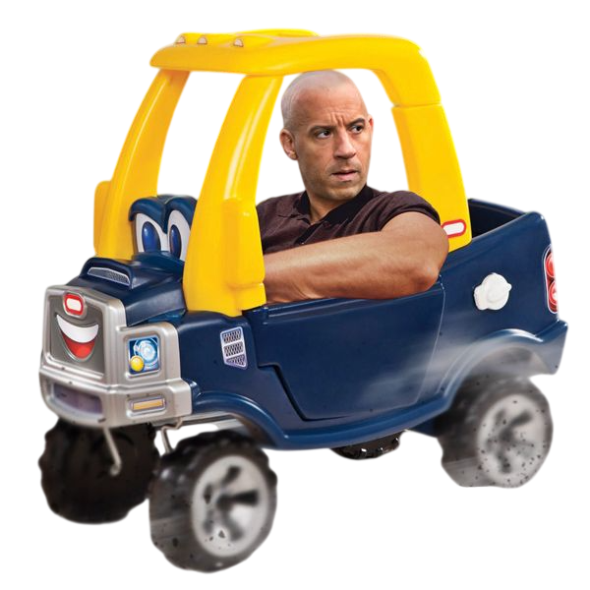
Thank you for your attention!

